Slide 1

ASR Process Flows and Database Structure

Slide 2
Learning Objectives
Describe Process Flows in NightFire ASR
Describe NightFire ASR error handling
List the required forms for ordering services.
Describe the ASR database structure.

Slide 3
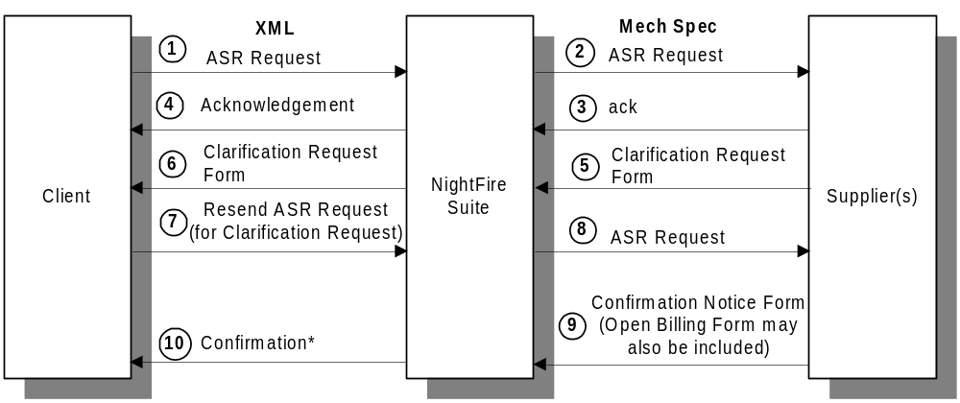
ASR Ordering Workflow

Slide 4
ASR Message flow
Asynchronous
Transaction vs Transmission
  1-5 transmissions a day from the NightFire Suite to the supplier.
  1 Mech Spec file per transmission.

Slide 5
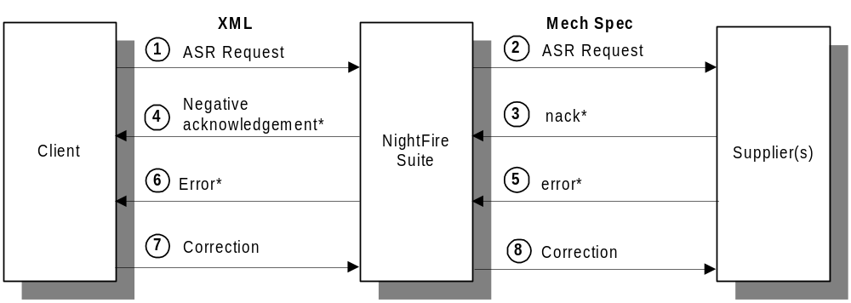
ASR Workflow Error Handling

Slide 6
Message Header
<?xml version=“1.0” encoding=“UTF-8” standalone=“yes”?>
<header>
  <Request value=“asr_order”/>
  <Subrequest value=“asr_order”/>
  <Subtype value=“<leave this value blank>”/>
  <Supplier value=“<trading partner>”/>
</header>

Slide 7
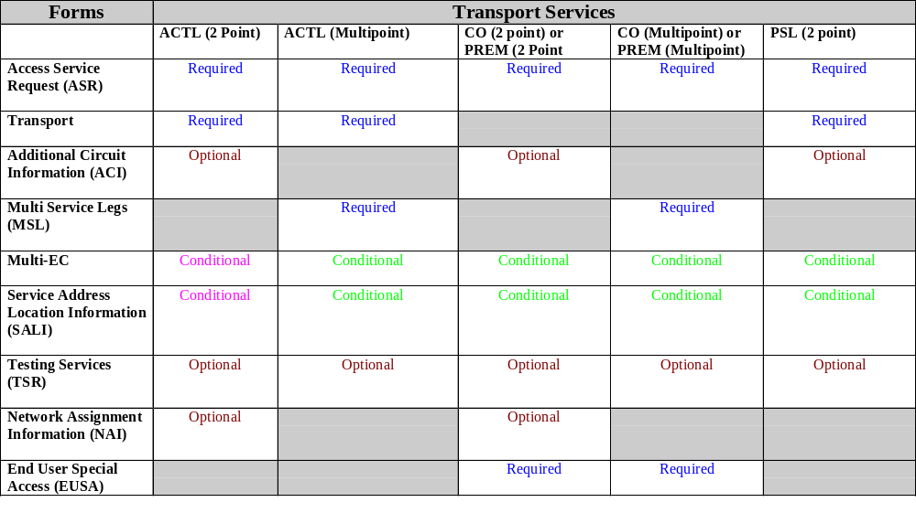

Slide 8
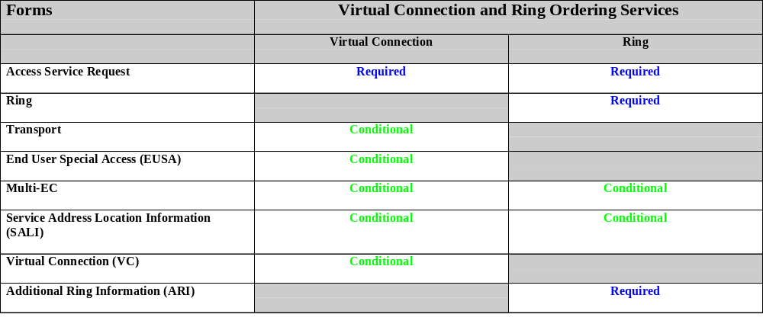
Virtual Connection and
Ring Ordering Services

Slide 9
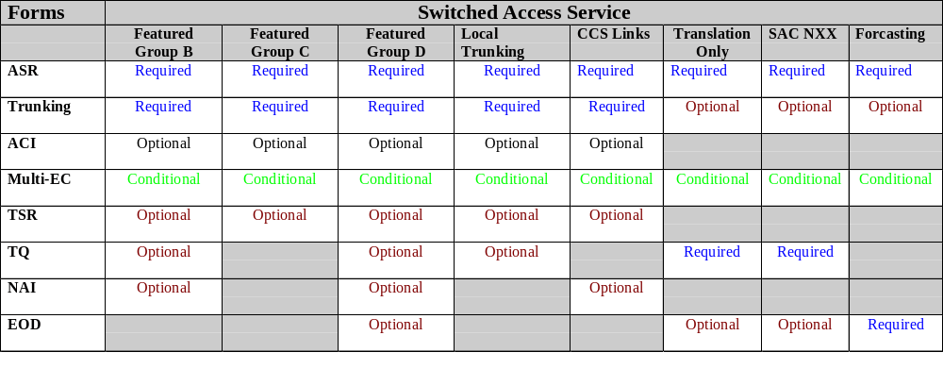
Switched Access Service

Slide 10
Error Handling
Communications Errors
Data Errors
System Errors

Slide 11
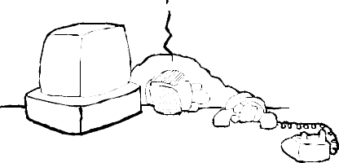
Communications Errors
Occur when the communications between a client and supplier is down.

Slide 12

Data Errors
Occur when required fields are missing or contain the wrong kind of data.
XML mapping errors

Slide 13
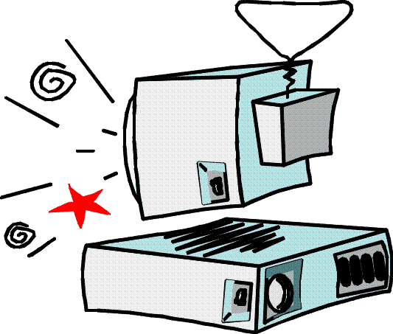
System Errors
Occur when one or more of the NightFire Suite servers is down.

Slide 14
Error Handling
Errors are logged in diagnostic log files
Located in the <install>/logs directory
Text of request/response msg that generated the error is saved in the log along with error message.

Slide 15
Request/Response Message
Error Handling
Connect:Direct Communications
  <install>/<spi>/exception Directory
Not using NightFire GUI
  Mapping and data error with requests
Response fails from supplier due to mapping, data, or system error
  <install>/<spi>/error Directory

Slide 16
API Exceptions
System Exceptions
Data Exceptions

Slide 17
Data Exceptions
processAsync and processSync methods throw an InvalidDataException if message cannot be processed due to invalid header or content.
InvalidDataException tells client
  Check the content and format of the input message and header before resubmitting the order.

Slide 18
InvalidDataException
errorType
  UnknownDataError
  MalformedDataError
  MissingDataError
  InvalidDataError
errorMessage

Slide 19
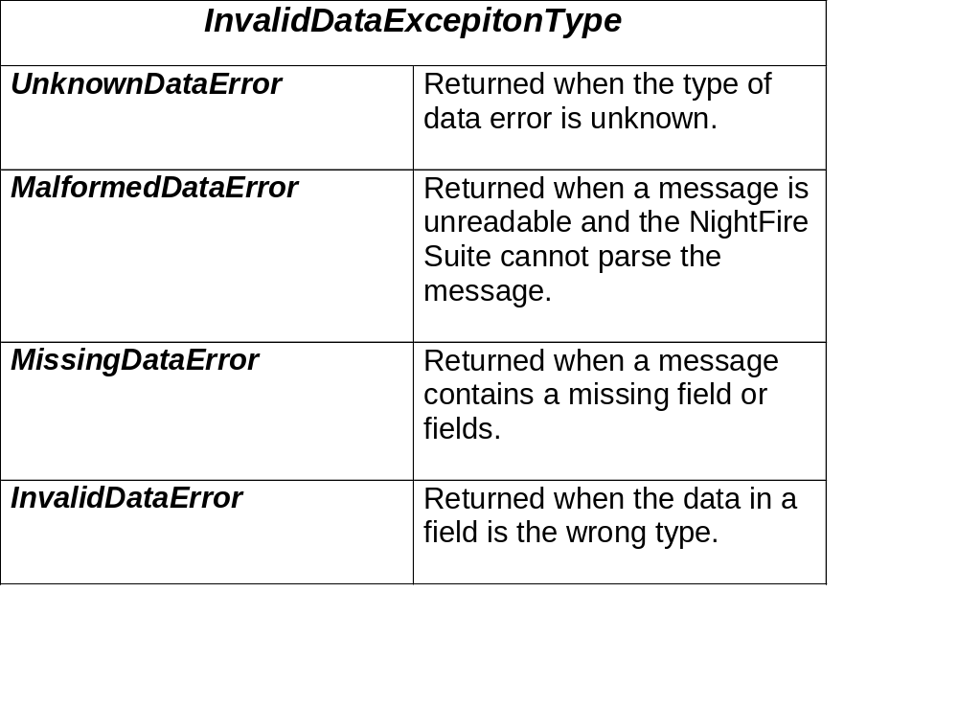
errorType

Slide 20
System Exceptions
processAsync and processSync methods throw a CorbaServerException if the message cannot be processed due to a system error.
CorbaServerExceptions tells the client to check the indicated component before resubmitting the message.

Slide 21
CorbaServerException
errorType
  UnknownError
  DatabaseError
  CommunicationsError
  AccessDeniedError

Slide 22
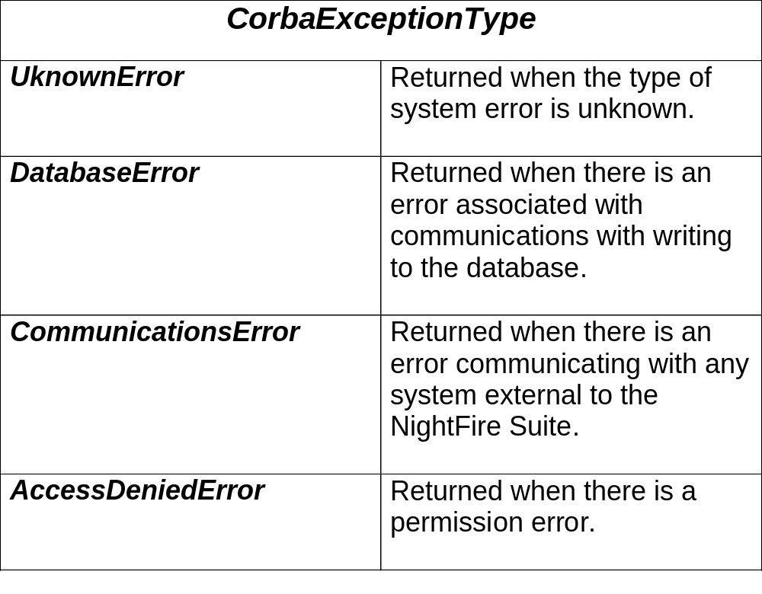
errorType

Slide 23
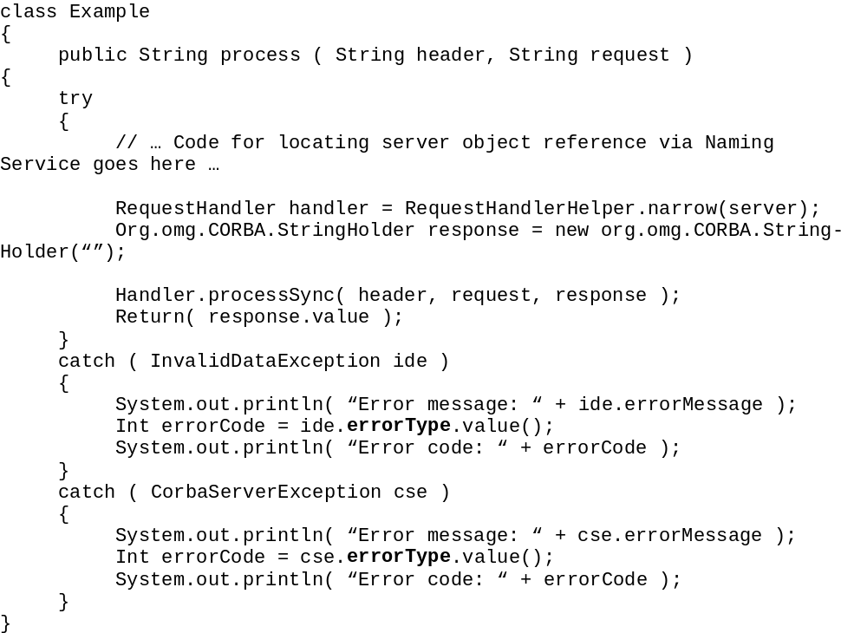
Accessing errorType

Slide 24
XML Mapping Error Handling
XML mapping generate error messages in the SPI logs and exception directory.
Error code number and error message
Consult ASR Integrator guide for XML mapping error codes.

Slide 25
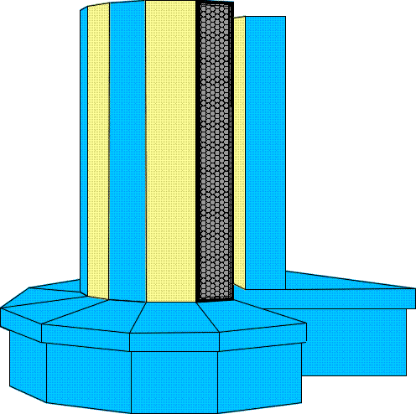
ASR Database Structure

Slide 26
ASR Client-Side Logging
Client-side logging refers to messages which are logged in NightFire’s standard XML format prior to mapping to the MECH SPEC format as well as responses from the supplier after they have been mapped from MECH SPEC to XML.
Client
NightFire
Suite
Supplier
ASR_MESSAGE
MECH_SPEC

Slide 27
ASR Supplier-Side Logging
Supplier-side logging refers to messages which are logged in the MECH SPEC format prior to transmission to the supplier as well as MECH SPEC messages received from the supplier.
Client
NightFire
Suite
Supplier
ASR_MESSAGE
MECH_SPEC

Slide 28
ASR Database Tables
ASR_MESSAGE and MECH_SPEC tables contain:
  Service order requests
  Synchronous responses
  Asynchronous responses
  Notifications

Slide 29
ASR Database Tables
ASR_MESSAGE
ASRMessage_key
seq_no
pon
ccna
ver
message_type
act
asr_no
timestamp
message
MECH_SPEC
ASRMessage_key
Created
ILEC
Filename
Batchkey
Message

Slide 30
Summary
ASR Ordering Workflow
Ordering ASR Services
Error Handling
API Exceptions
ASR Database Structure

